Slide 1
USER INTERFACES for EMBEDDED SYSTEMS
Lecture 10: Performance Metrics
Stefan Wagner
sw@eng.au.dk

Slide 2
Agenda
Systematic usability evaluation with Metrics
Definition of Metrics
Different types of Metrics
Choosing the right Metric
Exercise

Slide 3
Systematic usability evaluation
If we want to learn whether design prototype A or B is best
We need a way to say A > B, B > A, or A = B
To do so, we need our data to be comparable: “Metrics”
Our methods must be valid and reliable
Thus, we need our evaluation to be relevant, representable, systematic, and reproducible
Thus, we need to define a series of experiments to support our arguments – with sufficient data to give us the statistical power we need (number of test users, number of test cases)

Slide 4
Exercise
Take 10 minutes and discuss what is actually relevant to test in your prototypes?
Is it enough with a simple test?
Do you need to test with the same participant many times?
Should the participant receive training?
Should you redo the tests over longer periods of time?

Slide 5
Metrics: What?
What are metrics?
A way of measuring or evaluating a particular phenomenon
Metrics should be
General
Standardized
Consistent
Reliable
Observable
Quantifiable
Think of: Length (the meter), mass (the gram) etc.
Système international d'unités (SI)

Slide 6
Metrics: Why?
Improve your products
Help design decisions
Estimate size and magnitude of issues
Compare designs and design iterations
Reveal patterns
Improve your project reports
Structure experiment designs
Test your hypotheses
Stronger conclusions

Slide 7
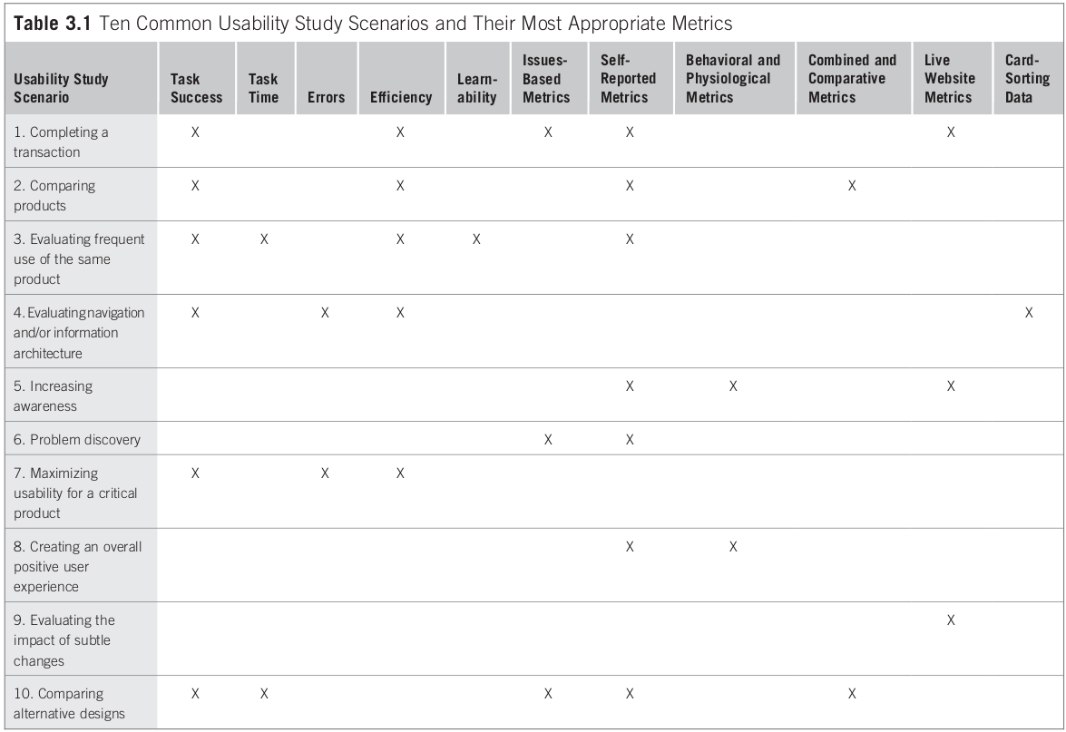
Different scenarios require
different metrics
[T&A]

Slide 8
User goals: Performance
Performance is about what the user actually does when interacting with the product
Measuring degree to which users can successfully accomplish tasks:
How long does it take to perform a task?
How much effort does it take to perform a task, e.g.
mouse clicks or cognitive load
Number of errors committed
Learnability: How long does it take to become proficient?
Users must be able to perform key tasks successfully
We will return to performance measures later

Slide 9
User goals: Satisfaction
Satisfaction is about what the user says or thinks when interacting with the product
The user might report that the product, e.g.
is easy to use
is confusing to use
exceeded expectations
is visually appealing
is untrustworthy
If the user is not satisfied, he is unlikely to, e.g. buy the product or spend time on the website
Satisfaction is a self-reported metric. They will be reviewed later

Slide 10
Choosing the right metrics
Most usability studies have unique qualities
When choosing your metrics, consider, e.g.
Study goals
User goals
Time-line, resources, budget, etc.
Possibilities of data acquisition
Data types
Explore your raw data and develop new metrics if needed

Slide 11
Performance metrics (PM)
Task success
How effectively users are able to complete set of tasks
Time-on-task
How much time required to complete a task
Errors
How many errors are made while completing a task
Efficiency
Effort to complete a task, e.g. number of mouse clicks
Learnability
How performance changes over time, i.e. learning as we go
Performance metrics are good at identifying what is wrong (effect), but not why (cause)

Slide 12
PM: Task success
Binary success
True or false: Either succeed or fail
Frequency of users succeeding per task
Levels of success
Extent of task completion: numerical value or percentage to each level
Experience in completing the task: Easy, medium, struggling
Way of task completion: Optimal way or alternative way
User segmentation
Frequency of use, previous experience, expertise, age, gender, etc.
Issues
When to stop, i.e. how long time to give the user
Define success criteria, task end state

Slide 13
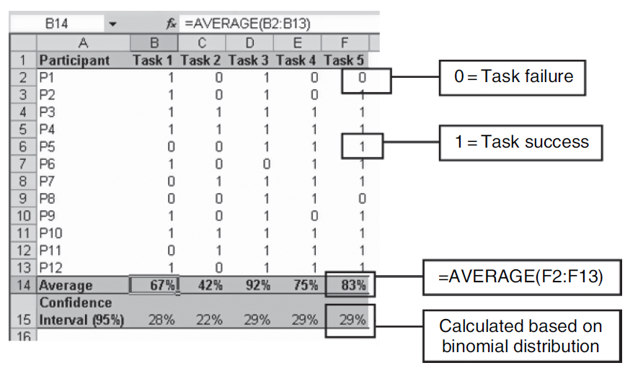
Binary success

Slide 14
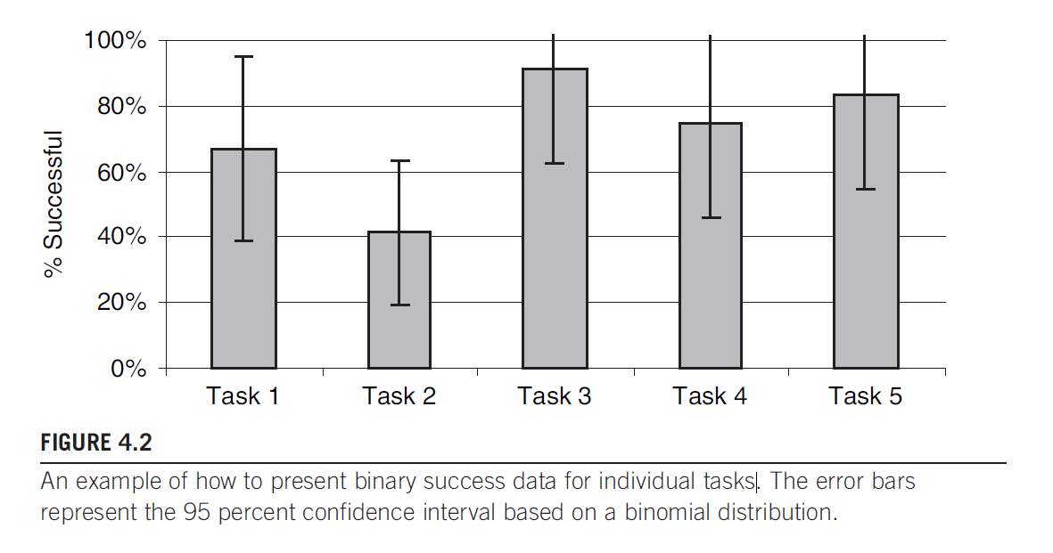
Using binary success

Slide 15
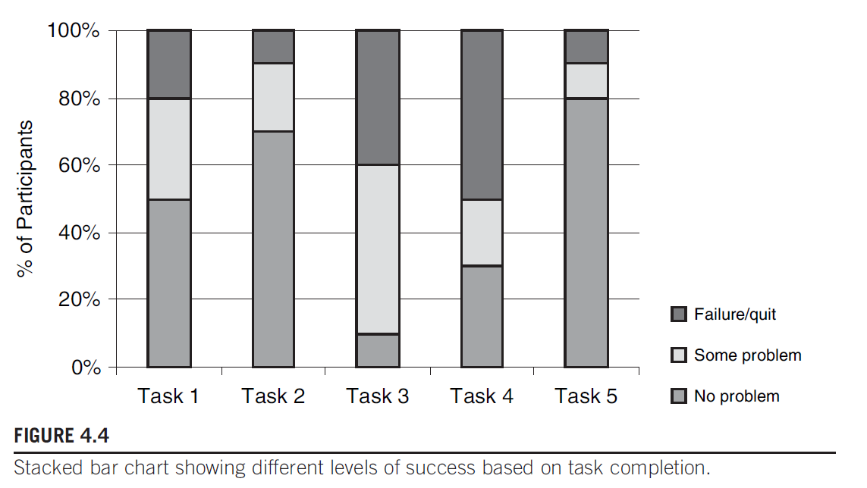
Visualizing different problems

Slide 16
PM: Time-on-task (1/2)
Time-on-task = Δt = t_{Task-End} -t_{Task-Begin}
Also known as “task completion time” or “task time”
Very important Metric for:
Frequently carried out tasks (expert users with many similar tasks)
Multi-user scenarios with peak stress (kiosk systems)
Timing: Automatic or manual
Auto timestamps via tools or code instrumentation
Manual timestamps via stop watch
Average amount of time spent: mean or median
Good for comparing effectiveness of design A vs B

Slide 17
Micro exercise (5 minutes)
Discuss with your neighbor:
How can we automatically record Time-on-Task?
How would you store it – and how would you get it into e.g. Excel?
What happens if you use the Think Aloud Protocol with Time-on-Task?

Slide 18
PM: Time-on-task (2/2)
Issues
When to stop the clock?
Use data only from successful tasks?
Is experiment influencing time, e.g. think-aloud protocol
Should the users know they are being timed?
Influences exploratory behavior, nervousness, etc.
Filter outliers? What if user is interrupted?
Apply training before starting?

Slide 19
PM: Errors (1/2)
Measuring errors may be important if
They cause loss of efficiency
They result in significant extra costs
They result in task failures
Single or Multiple error opportunities
Counting errors
Frequency / percentage of errors per task
Percentage of users that makes an error in each task
Define acceptable error levels, e.g.
20% of tasks had error rate above acceptable level (10%)

Slide 20
PM: Errors (2/2)
Errors are not issues
Issues are the cause of errors (effect)
Issues
Need to define correct actions to know when errors occur
May need to classify types of errors
Do not double count errors

Slide 21
PM: Efficiency (1/2)
Amount of effort required to complete a task
Physical load
Cognitive load
Not just time, but also actions, e.g.
Number of steps/actions required to complete a task
Average no. of actions per task for each participant
Number of mouse clicks and/or key presses
Combine tasks success, time, and actions
When completing a task successfully:
How much time spend? No. of actions performed
When failing a task
Time spend / actions performed before giving up?

Slide 22
PM: Efficiency (2/2)
Issues
Define which actions to count
Define when to start and end counting actions
Cognitive load
Mental actions can be hard to measure
Cognitive load is hard to measure
Physical load
Mouse clicks and key presses are easy to measure
Additional mouse clicks done to explore the interface?

Slide 23
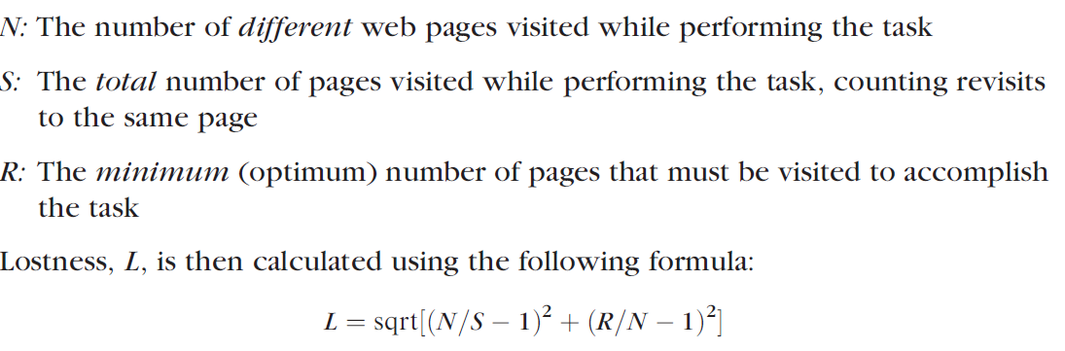
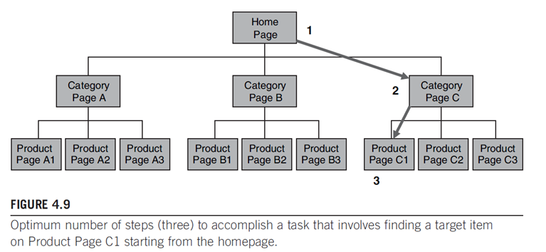
Example: Web “Lostness”

Slide 24
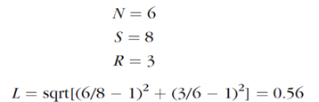
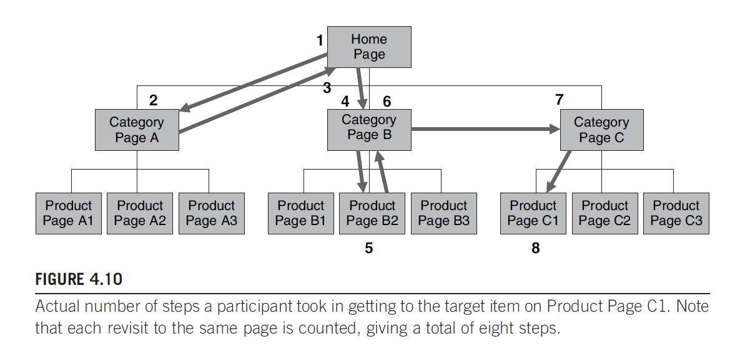
Example Web “lostness” (2/2)
Can be measured with standard statistics web module
Perfect Lostness L = 0

Slide 25
PM: Learnability (1/2)
Develop a metric that is a function of time and trials
Success rate
Time-on-task
Number of errors, etc.
Demonstrate a learning curve within or between sessions
Interpret the curve and look for oddities
Plot as graph and look for
When and if it flattens out, i.e. no more learning occurs
Time spend / trials done before max performance reached
Difference between, e.g.
Learning curve of experts vs. novices

Slide 26
PM: Learnability (2/2)
Issues
- How to define a trial
When does trial begin and end?
What if interaction and learning is continuous?
How much time should pass between trials?
- How many trials to include?
Minimum two, often more

Slide 27
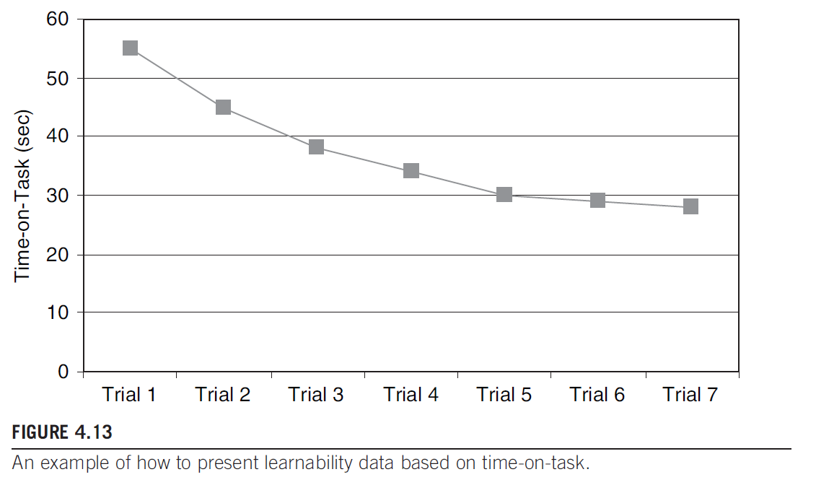
Visualizing Learnability

Slide 28
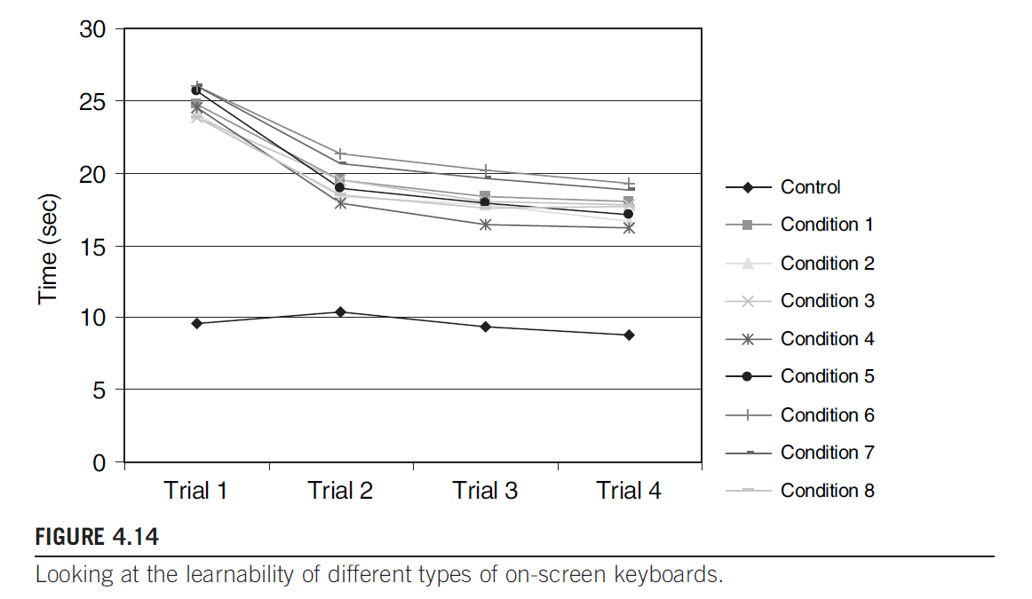
Comparisons

Slide 29
Exercise
How will you be able to say prototype A > B
Create a test plan for measuring performance metrics
In a document
- Discuss which tasks you plan to compare
- Discuss what knowledge you plan to gain (your research question)
- Discuss which metrics you plan to use (focus on performance metrics)
- Discuss how many participants you need, and how much time is needed
Recruit test users and do the evaluation!

Slide 30
References
[T&A] Tullis and Albert, Measuring the User Experience, 2008
[S,R&P] Sharp, Rogers, and Preece, Interaction Design, 2002
[JN] Jakob Nielsen, Usability Engineering, 1994
[JR] Jeffrey Rubin, Handbook of Usability Testing, 1994
[JJG] Jesse James Garret, The Elements of User Experience, 2002

